Slide 1

SIMATS ENGINEERING COLLEGE
CSA4002 - MANAGEMENT INFORMATION SYSTEM
MIS for Agricultural Supply Chain Management
Guided By: Dr.Mary Harin Fernandez
Presented By:
Roghit V (192121011)
Karthik K (192124014)

Slide 2


MIS for Agricultural Supply Chain Management
The implementation of a Management Information System (MIS) for agricultural supply chain management is crucial for tracking the distribution of agricultural produce from farmers to retailers. This system enhances efficiency, reduces waste, and provides real-time insights into crop demand trends and pricing. By integrating ERP, Business Intelligence, and Data Warehousing techniques, agricultural managers can make informed decisions that optimize the supply chain.

Slide 3


Overview of MIS in Agriculture
1
Data Collection
2
Data Analysis
3
Dissemination
Gathering data from various agricultural sources.
Analyzing data to inform decision-making.
Sharing insights with stakeholders for better management.

Slide 4




System Architecture
Data Sources
Data Processing
Supplier farms, market data, and consumer demand.
ERP systems for transaction management and Business Intelligence tools for analytics.
Data Storage
User Interface
Data Warehousing for historical data analysis.
Dashboards for real-time monitoring and reporting.

Slide 5
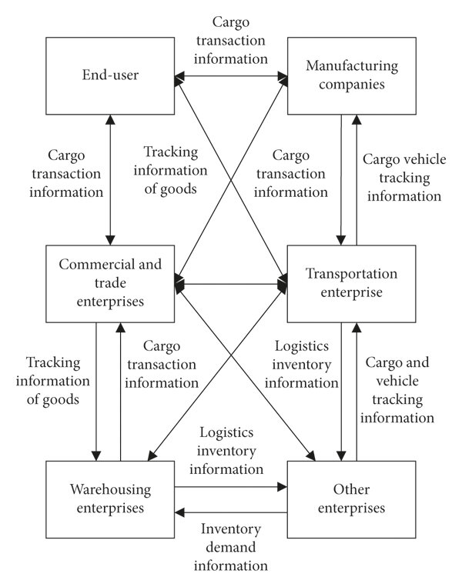

Slide 6

Key Features of the System
1
Real-time tracking
Monitor agricultural produce in real-time.
2
Automated reporting
Generate reports on crop demand trends automatically.
3
Pricing analytics
Analyze pricing for improved market positioning.
4
ERP integration
Seamlessly integrate with existing ERP systems.

Slide 7






Benefits of Implementing MIS
Improved Efficiency
Reduced Wastage
Enhanced supply chain efficiency through better tracking.
Minimized wastage by aligning supply with demand.
Better Decision-Making
Increased Profitability
Enhanced decision-making capabilities with data-driven insights.
Boosted profitability for farmers and retailers.

Slide 8
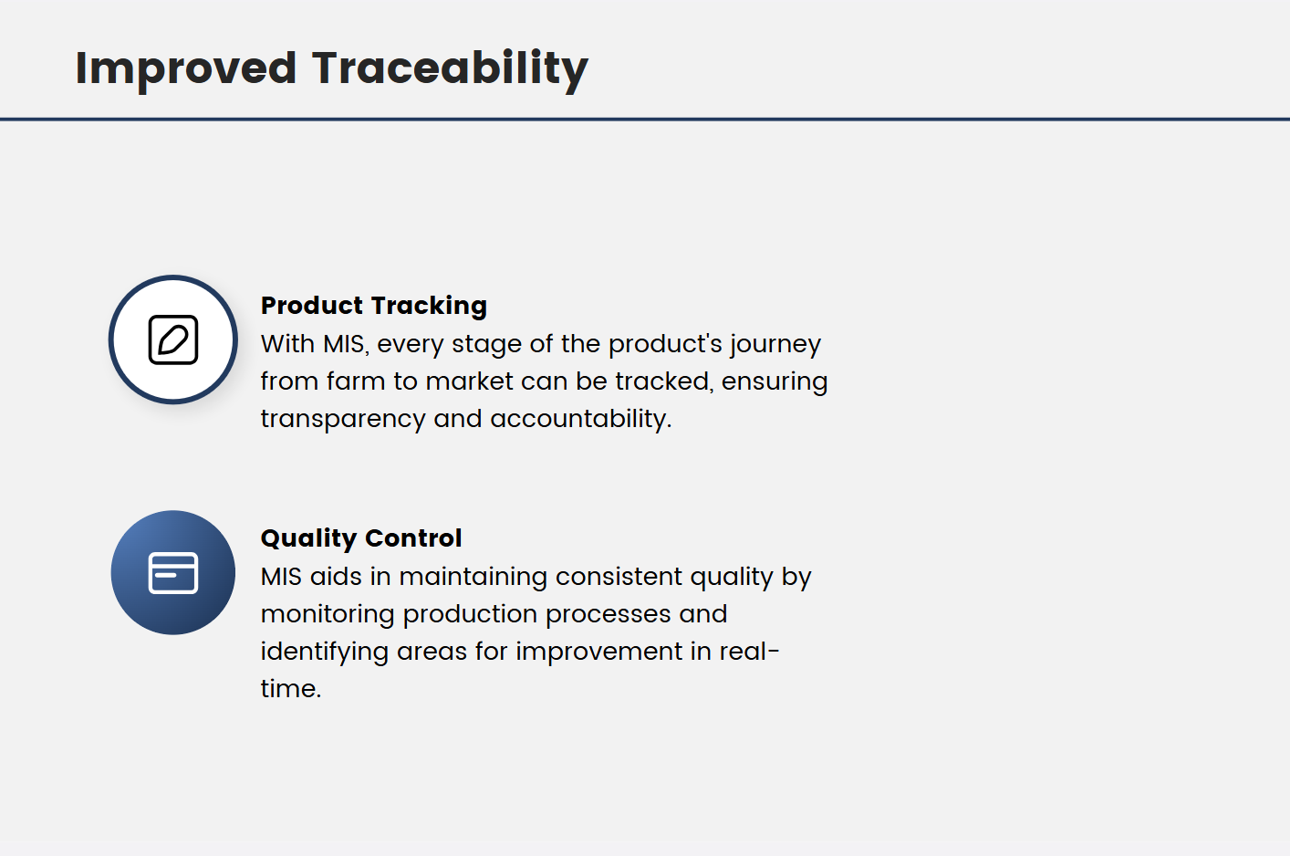

Slide 9


Data Collection Methods
Surveys and Interviews
IoT Devices
Market Analysis Reports
Conducting surveys and interviews with farmers and retailers.
Utilizing IoT devices for real-time data gathering.
Analyzing market reports for demand forecasting.

Slide 10
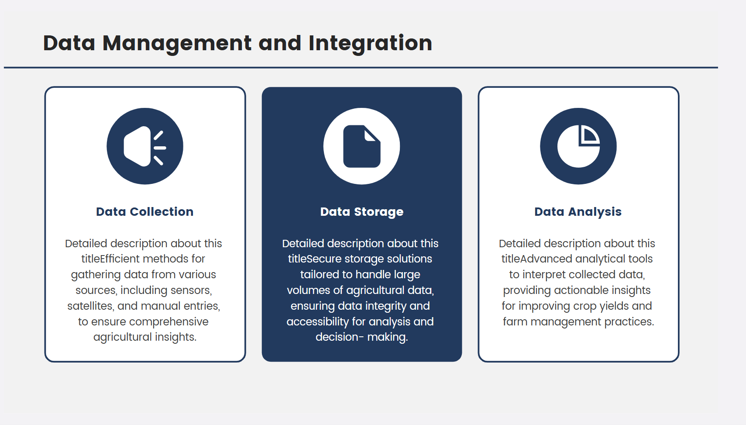

Slide 11

Real-time Pricing Analytics
1
Dynamic Pricing Models
2
Historical Pricing Trends
3
Price Fluctuation Alerts
Based on supply and demand.
For better forecasting.
To inform stakeholders.

Slide 12


Crop Demand Trends Analysis
Seasonal Demand Patterns
Consumer Preference Analysis
Predictive Analytics
Forecasting future crop needs for effective planning.
Identification of crop demand fluctuations throughout the year.
Utilizing data mining techniques to understand consumer choices.

Slide 13


Integration with ERP Systems
Streamlined Operations
Enhanced Inventory Management
Improved Financial Tracking
Achieve efficiency through integrated data flow.
Optimize stock levels and reduce waste.
Gain insights into financial performance and reporting.

Slide 14




Role of Business Intelligence
Visualization tools
Dashboards
Reporting tools
For effective data interpretation.
Provide real-time insights into supply chain performance.
Aid in strategic planning and analysis.

Slide 15




Data Warehousing in Agriculture
Centralized Repository
Historical Data Analysis
Complex Queries Support
A single source for all agricultural data.
Identifying trends over time for better decision-making.
Facilitating detailed reporting and analysis.

Slide 16



Challenges in Implementation
Data Quality Issues
Resistance to Change
Integration Complexities
Inconsistent and unreliable data can hinder decision-making.
Stakeholders may be reluctant to adopt new systems.
Difficulties in merging with existing systems can arise.

Slide 17
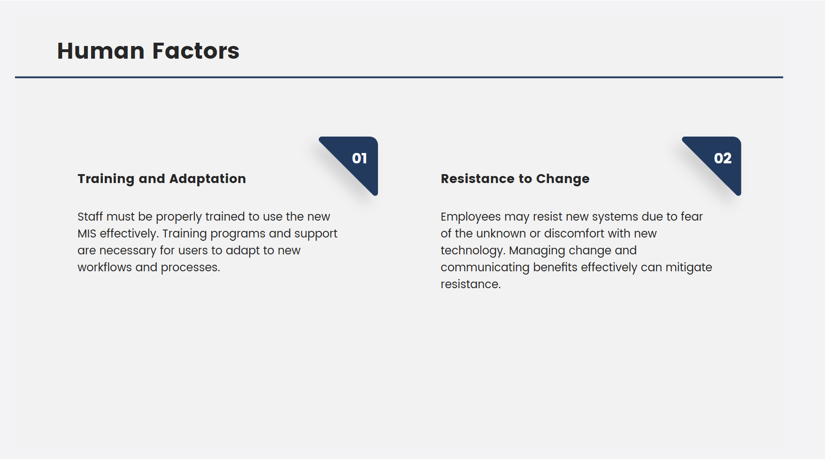

Slide 18




Training and Support
Comprehensive Training Programs
Ongoing Technical Support
User Manuals and Documentation
Tailored training sessions for all users.
Continuous assistance for system maintenance.
Detailed guides for easy reference.

Slide 19

Future Trends in Agricultural MIS
1
AI and Machine Learning
2
Mobile Access
3
Sustainability Focus
Enhanced access for on-the-go decision-making.
Greater emphasis on waste reduction.
Increased use for predictive analytics.

Slide 20

Conclusion
1
Efficiency Enhancement
2
Waste Reduction
3
Valuable Insights
Minimizes waste through better resource management.
Provides insights into crop demand and pricing.
MIS improves operational efficiency in agriculture.
BY:
Karthik K 192124014
Roghit V 192121011

